Slide 1



PROJECT DEPLOYMENT
Hanif Noe Rofiq
Shofinurdin
PJJ Data Analytics BDK Makasar

Slide 2
Objective
objective

Slide 3
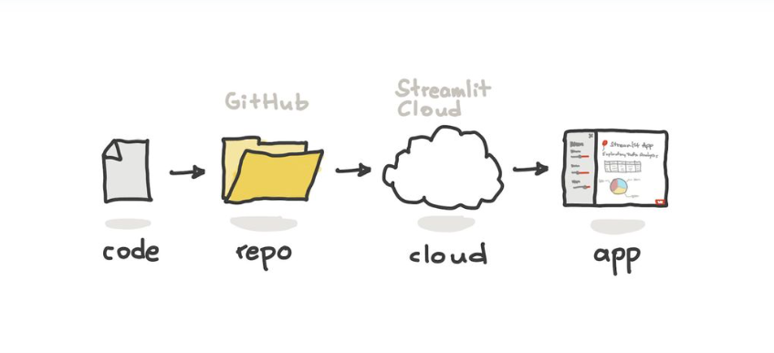
Deployment

Slide 4
Todo List
Install dan Setting VSCode
Membuat & export model
Deploy di local
Install git & upload project ke github
Deploy Project di Streamlit Cloud

Slide 5
Install & Setting VSCode
Download Install VScode
Install paket python di VSCode
Sinkron vscode python dan anaconda di virtual env
Membuat Virtual environment
Aktifkan virtual environment

Slide 6
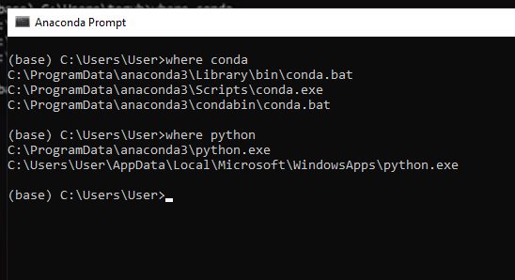
Sinkronisasi Terminal dengan anaconda

Slide 7
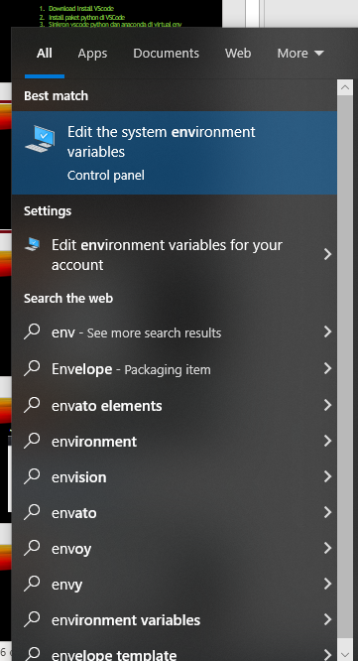
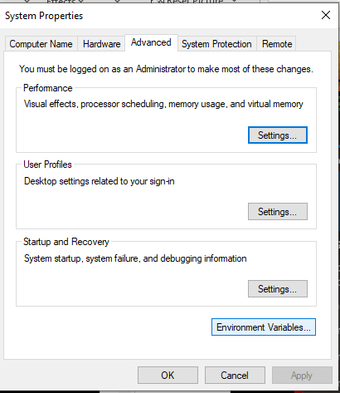
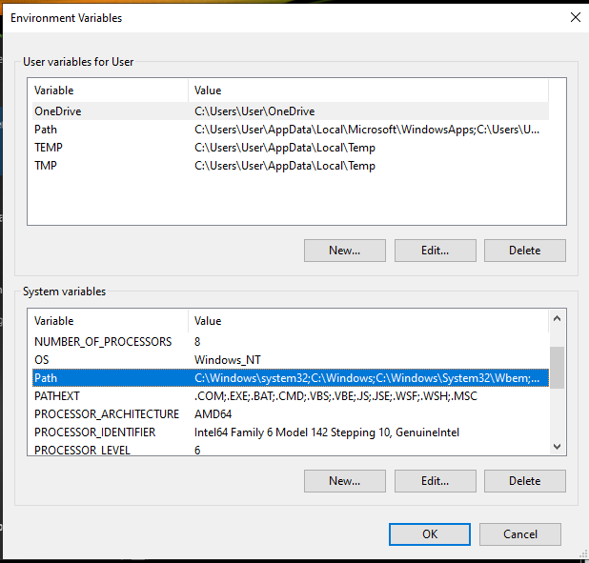
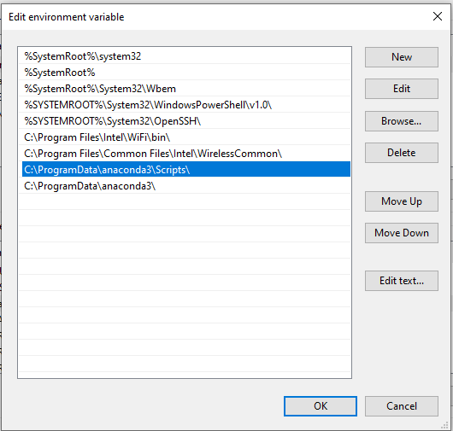
Membuat path di environment variable

Slide 8
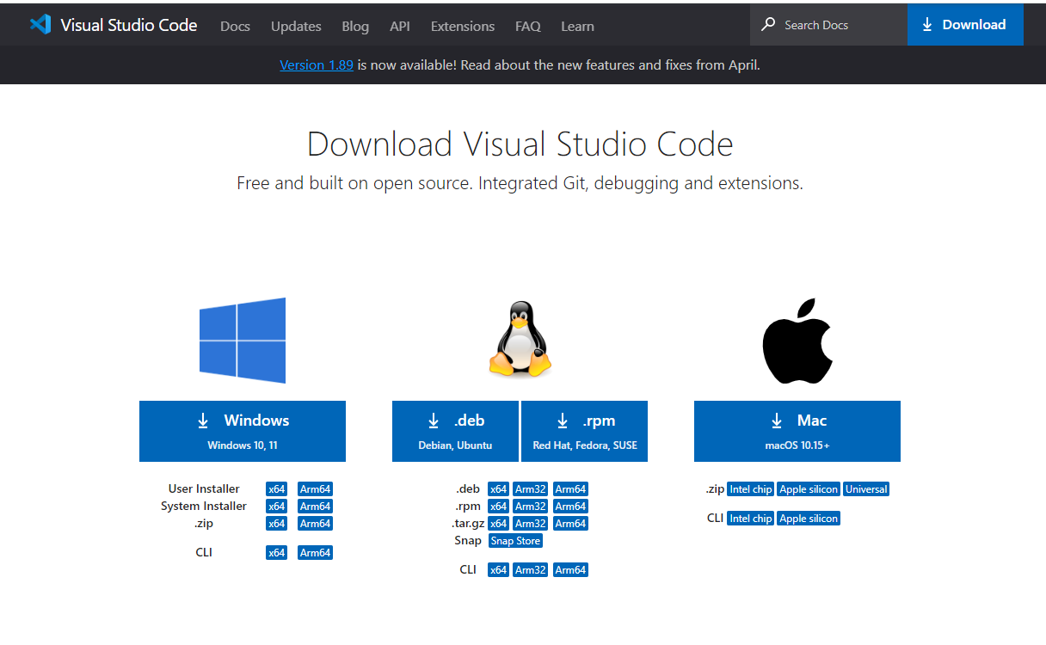
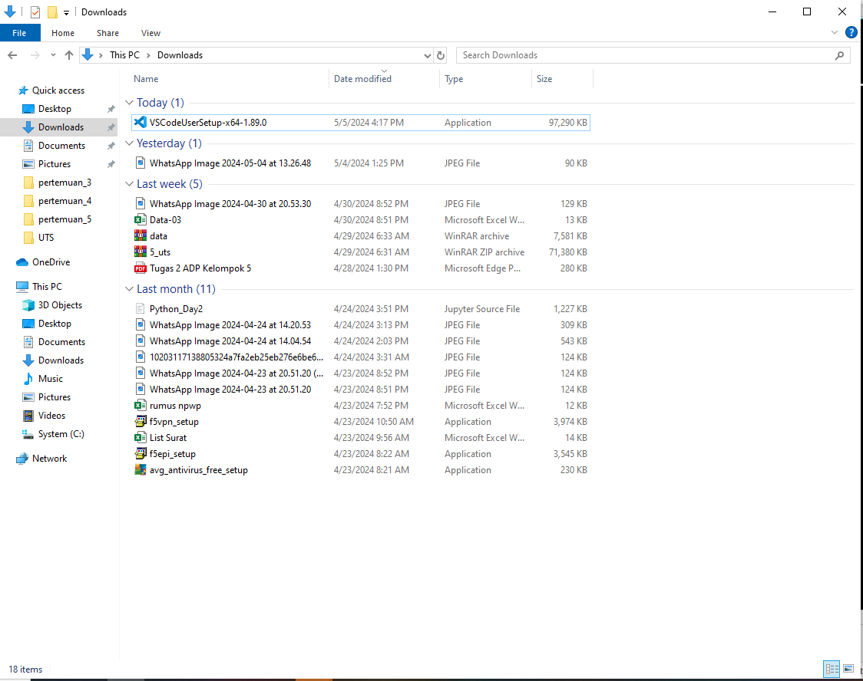
Download & install VScode
https://code.visualstudio.com/Download

Slide 9
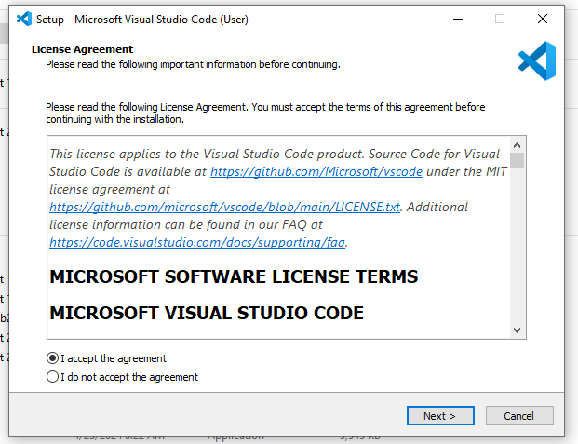
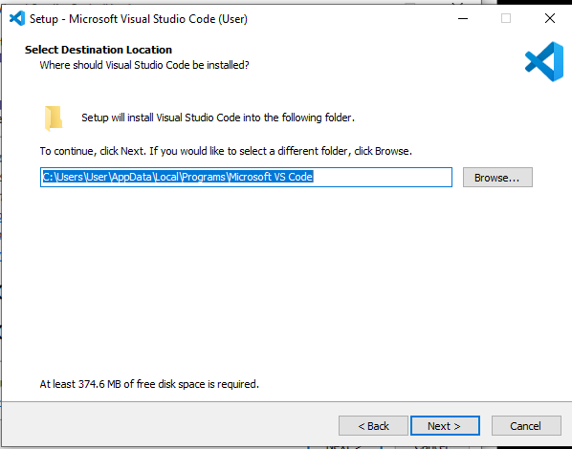
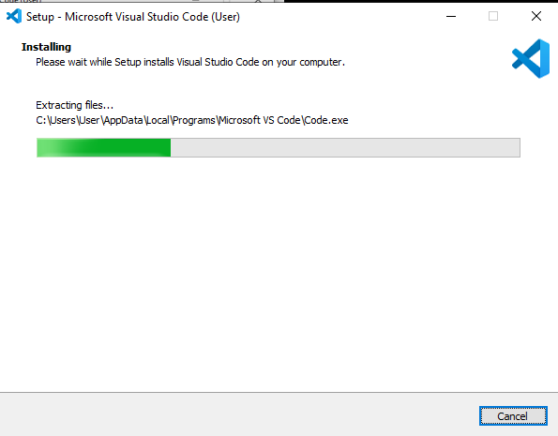
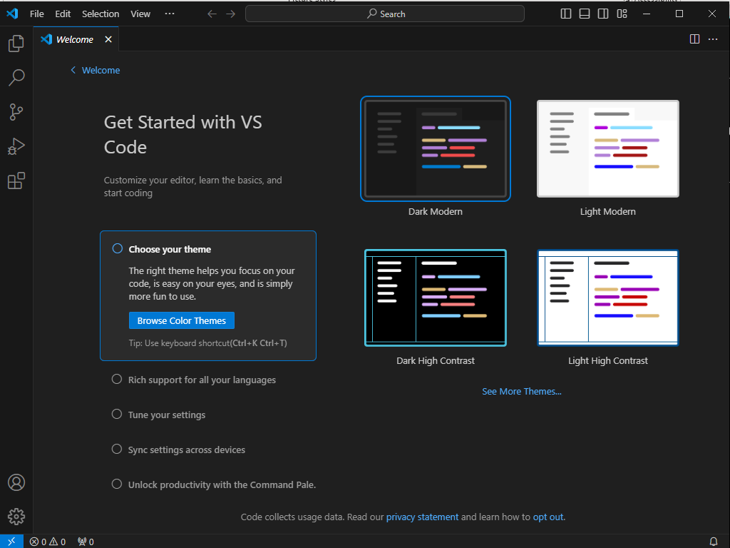

Slide 10
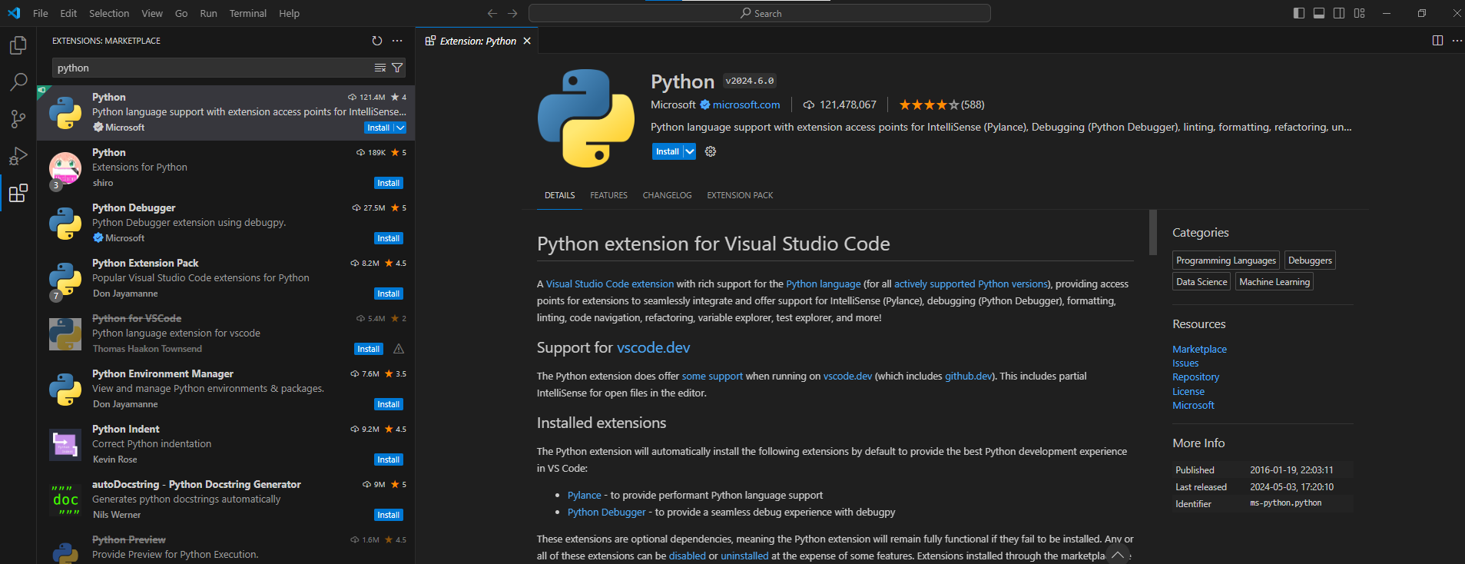
Install paket extension python

Slide 11
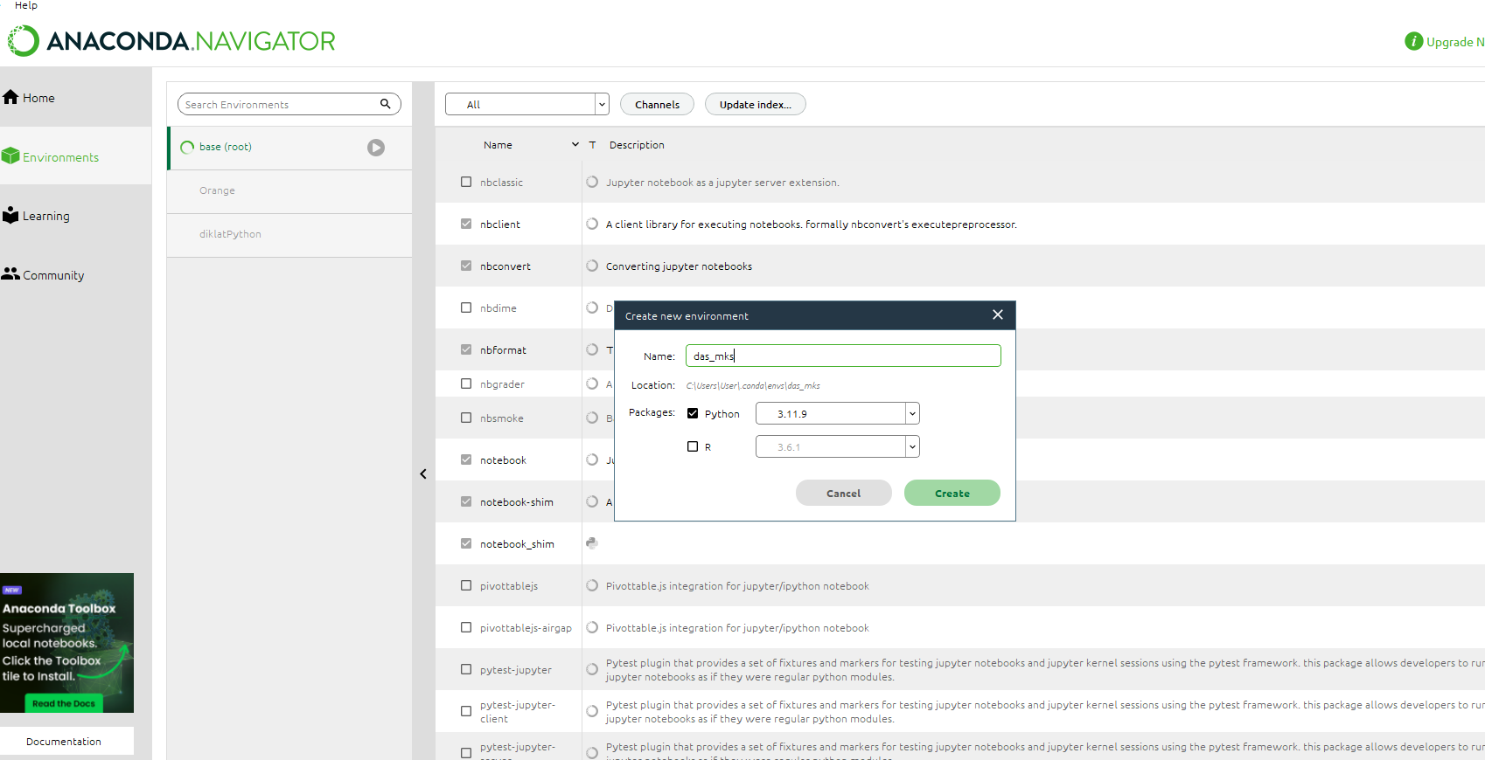
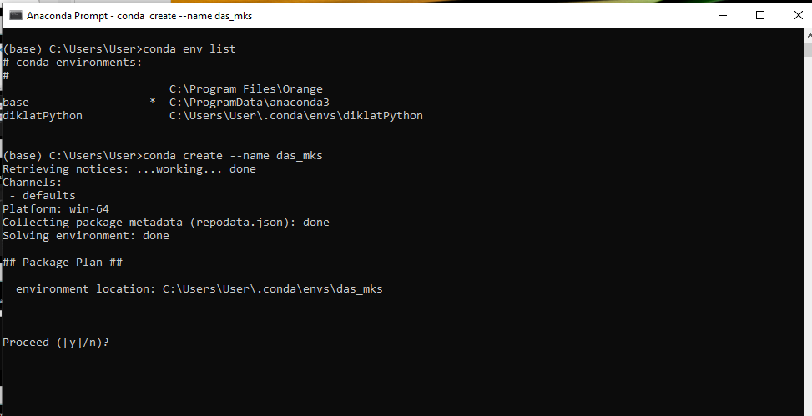
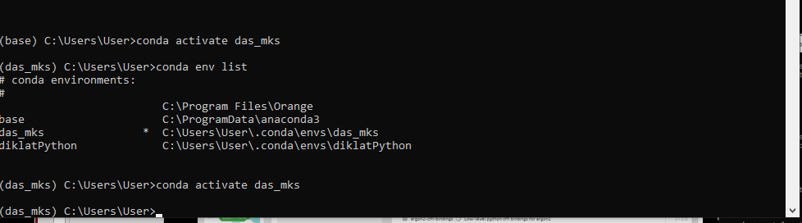
Membuat virtual environment
Mengaktifkan virtual environment

Slide 12
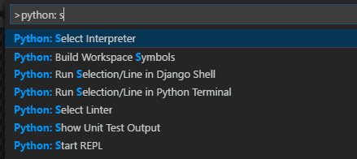
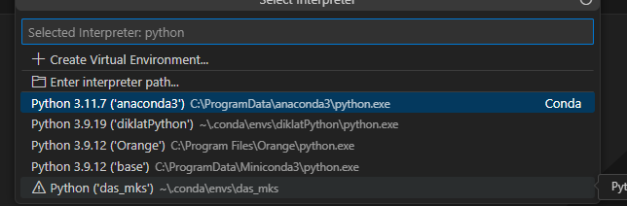
Select python interpreter
Select and activate an environment Python:
Select Interpreter command from the Command Palette (Ctrl+Shift+P).

Slide 13
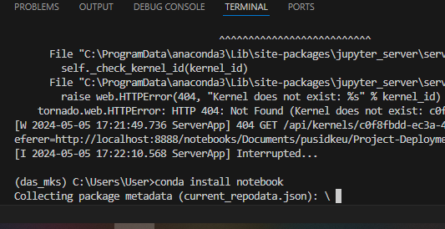
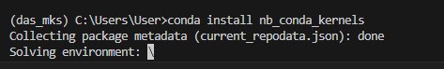
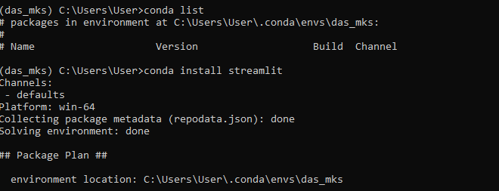
Install library
Install jupyter notebook
Install nb_conda_kernels / ipython kernel
Install streamlit dll (requirements.txt)

Slide 14
Modelling
Membuat model
Export model

Slide 15
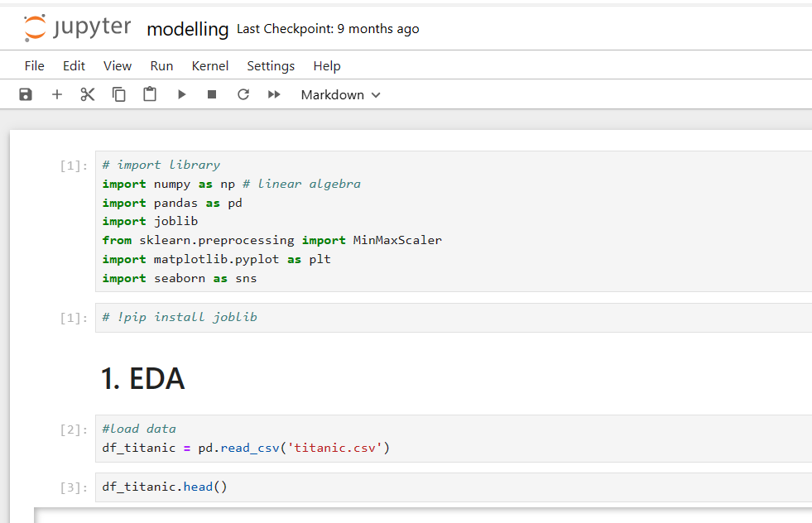
Modelling
Membuat EDA
Membuat Model
Export Model

Slide 16
Project local
Halaman Home
Halaman EDA
Halaman Predict

Slide 17
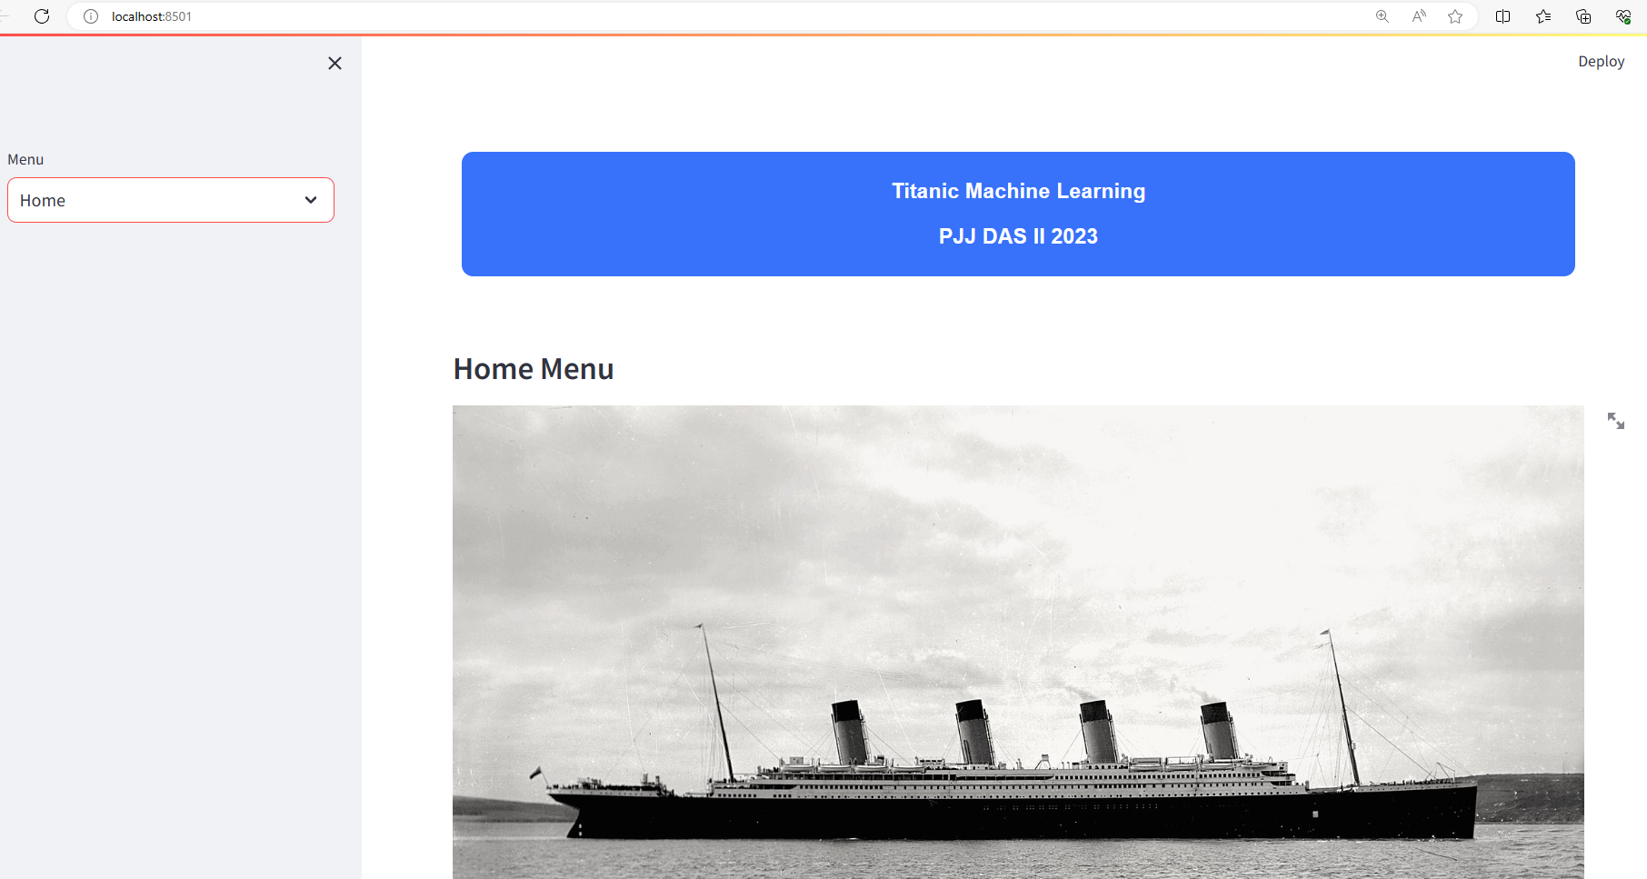

Slide 18
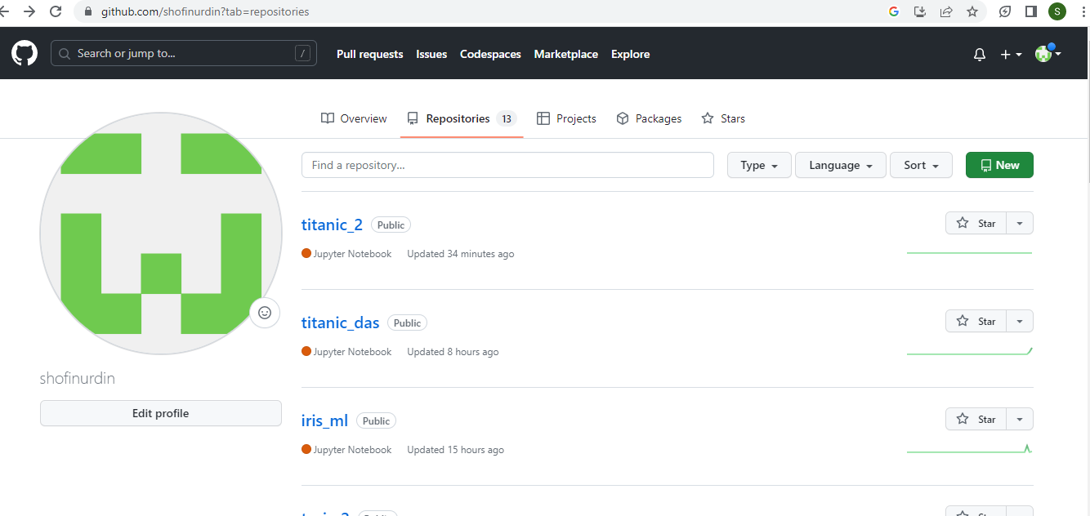
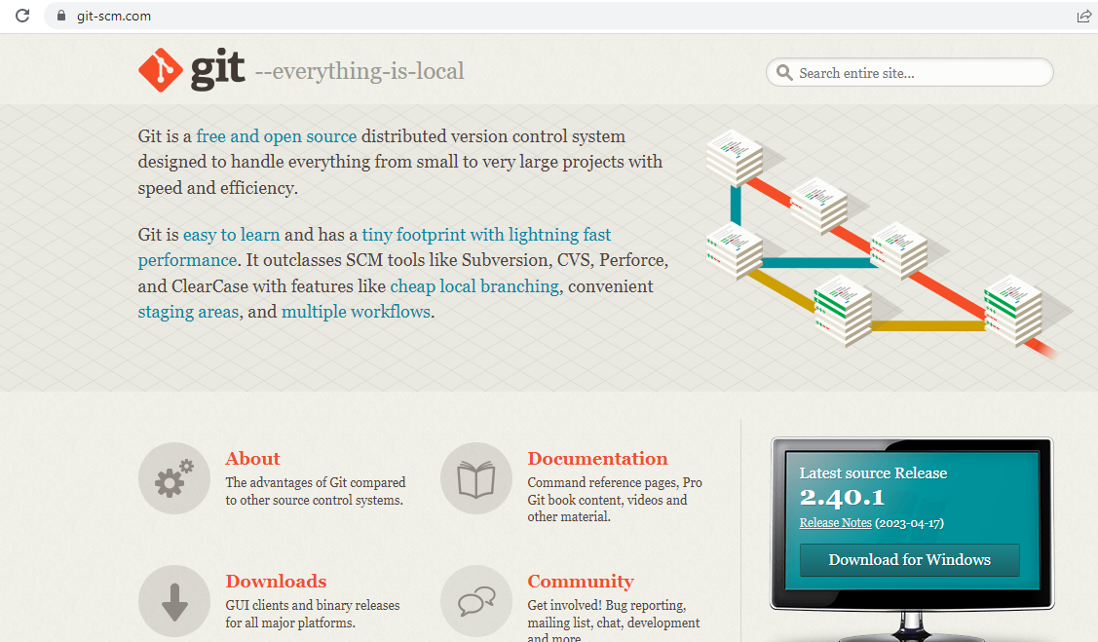
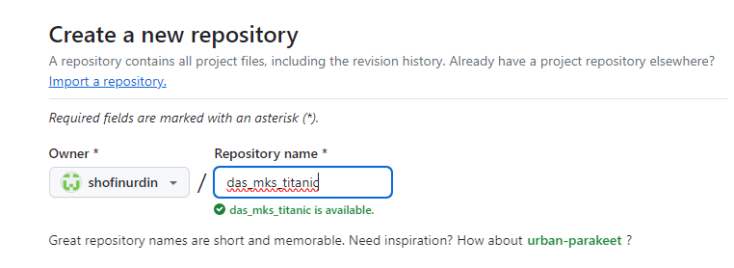
Upload ke Github
Membuat akun github
Membuat repository
Install gitlab
Upload project ke github

Slide 19
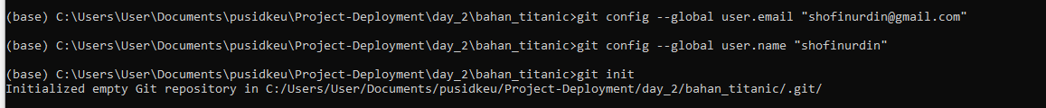
Uplod project

Slide 20
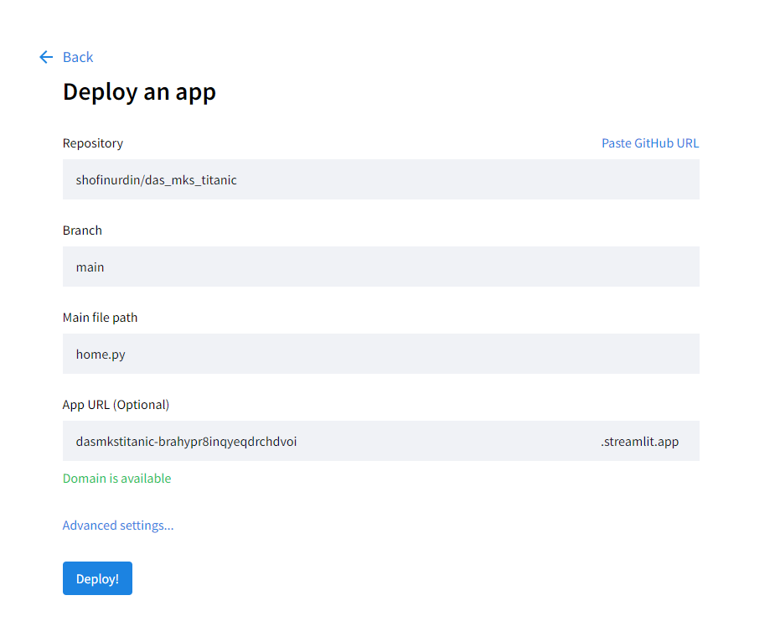
Deploy project di Streamlit Cloud
Membuat akun streamlit
Create Project dari github

Slide 21
Tugas
Deploy Iris Machine Learning
Membuat model
Eksport model
Import model di streamlit
Membuat halaman EDA
Membuat halaman predict
Upload ke github
Deploy ke streamlit cloud
Hasil.>>

